Slide 1
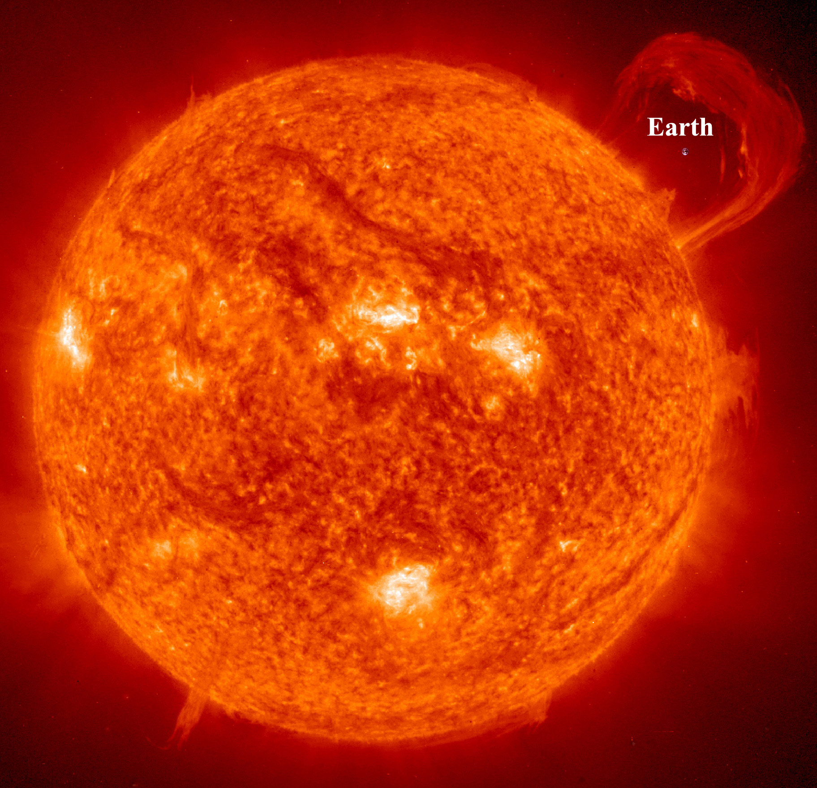
Coronal Mass Ejections
By Zak Titus

Slide 2
Outline
Introduction
General Outline of CMEs
How We Handle CMEs

Slide 3
Introduction
First two weeks spent in an intensive boot camp
Afterwards, shadowed primary forecasters during the day and helped to analyze space weather events
Worked on inputting data into the DONKI database

Slide 4
What is a CME?
An explosion occurring on the Sun that sends a wave of plasma into space
This wave has a mass of up to 10^14 kg and can travel at speeds of over 3000 km/s
The wave has an internal magnetic field that keeps it together as it travels

Slide 5
What causes CMEs?
CMEs are often associated with flares, but can occur independently of them as well
The exact reasons for the formation of a CME are not known, but it is believed to be associated with magnetic reconnection in the Sun’s magnetic field

Slide 6
How We Classify Them
CMEs are classified by their speed using the SCORER system:
S: <500 km/s
C: 500-999 km/s
O: 1000-1999 km/s
R: 2000-2999 km/s
ER: >= 3000 km/s

Slide 7
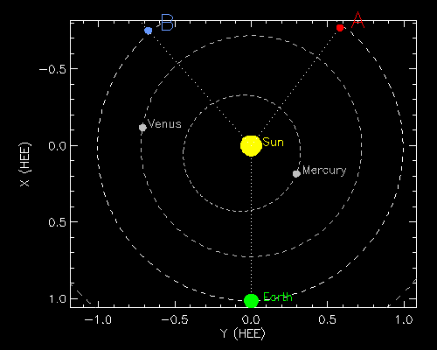
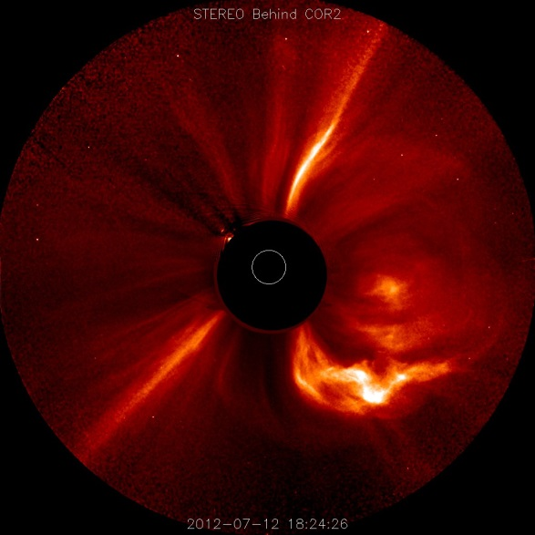
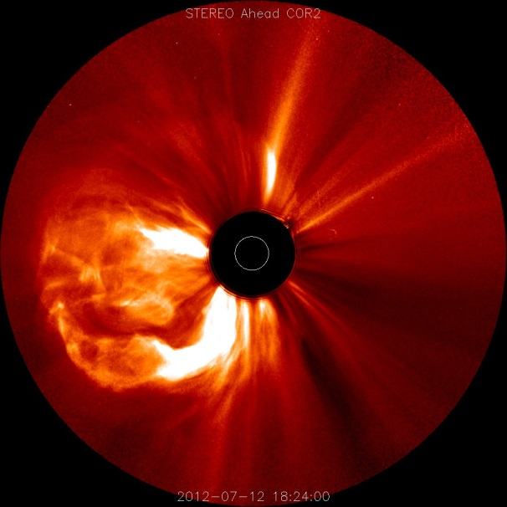
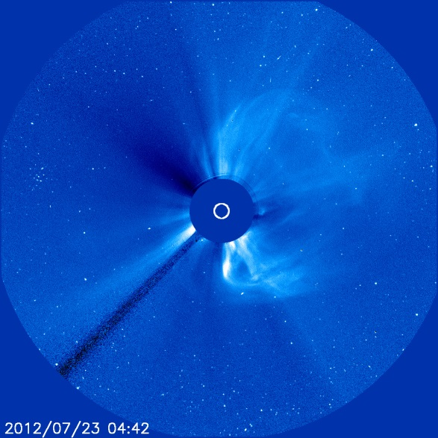
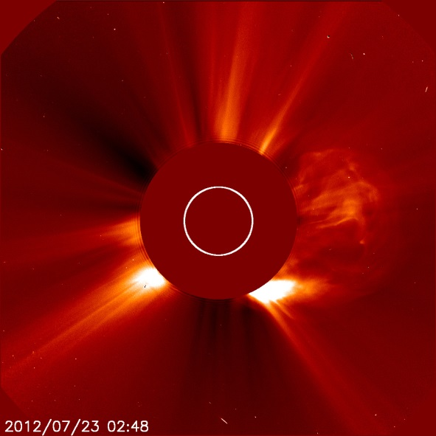
How We Measure Them

Slide 8
How we model them
After getting measurements from STEREO analysis, the CME is modeled based on the WSA-ENLIL model, which is then analyzed

Slide 9
Then what?
If a CME is predicted to have a noticeable impact, an alert is issued
This threshold is typically 500 km/s for Earth directed CMEs, and 1000 km/s for interplanetary CMEs
Alerts are sent out to all NASA mission operators

Slide 10
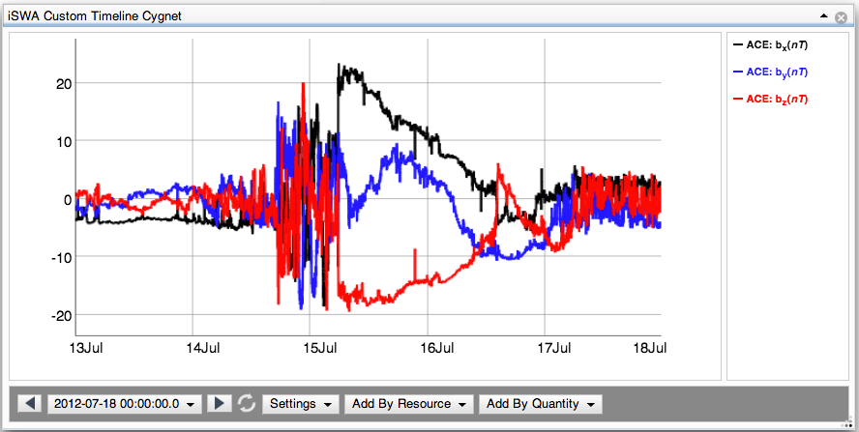
The results
CME impacts cause geomagnetic storms and solar energetic particle (SEP) events

